Slide 1
Microsoft AI Ecosystem
Unauthoritative Conceptual Infographic.
https://github.com/Pokeystuff/MSAIEcosystem

Slide 2




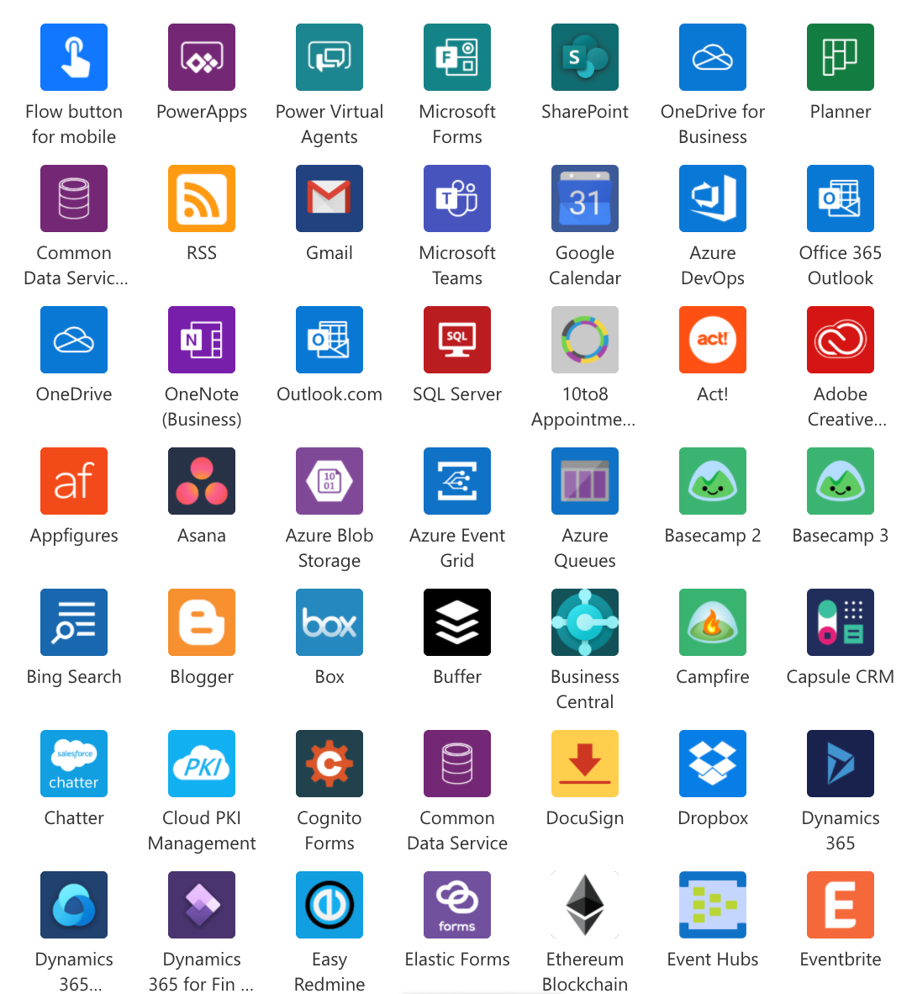



















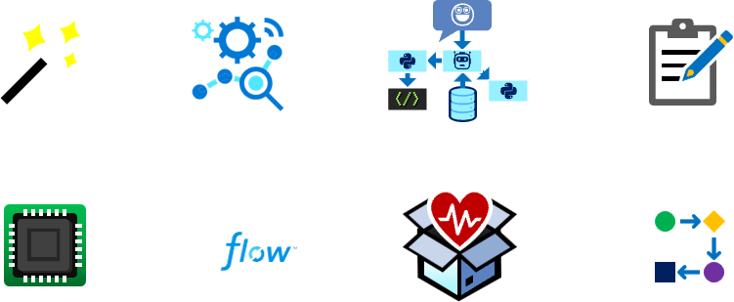


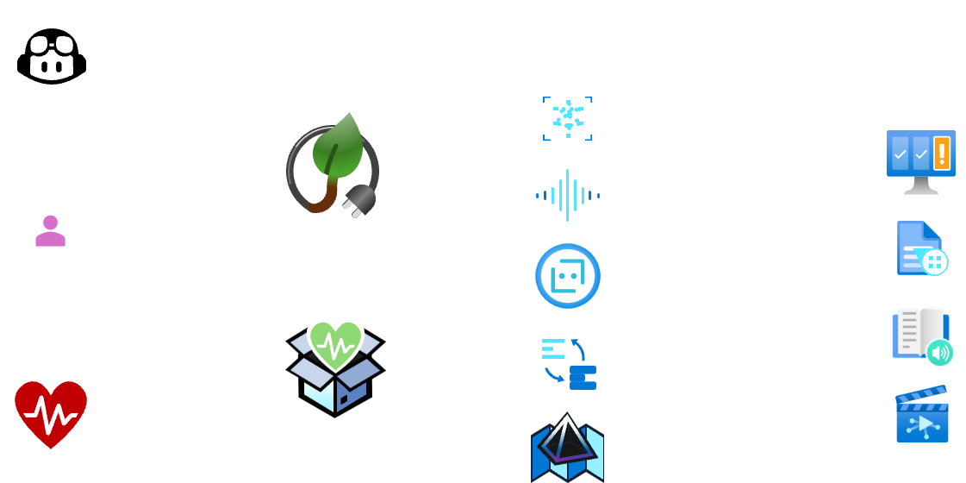
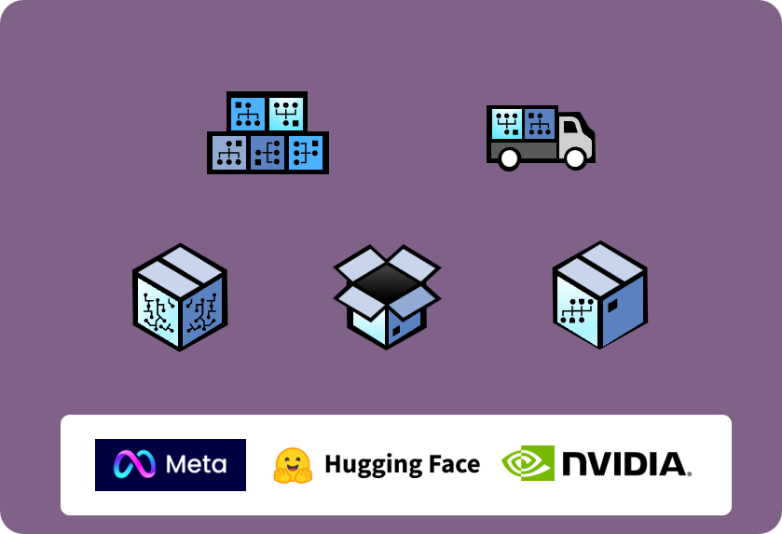

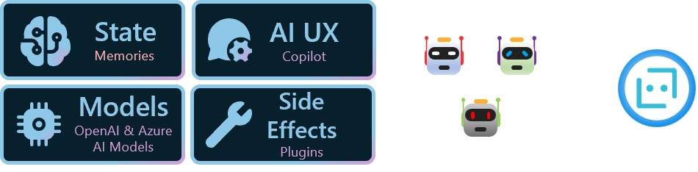


Microsoft AI Ecosystem
Format: PowerPoint Public Share Version
Use
Other AI enabled experience or process
Prompt Toolkit
A certainly incomplete view of services and resources available to utilize AI and build AI technology into your organization to achieve more with less.
Copilots
Build and use Plug-ins
Your Data
Low-code
Power Platform Connectors
(1000+)
Non-Microsoft Services or Apps
Azure Service
Other Clouds
Custom Data
Data Lakes / Storage / DB
On-premises
Power Platform
Copilot Studio
AI Builder
Azure Cloud Services
Build Copilots, AI enabled Apps and Business Automation without deep technical skills
Build and use Plug-ins
Microsoft Services
Copilot for Azure
SharePoint, Outlook
Teams, OneDrive, Viva, Sales, Finance and More…
Azure AI Studio
Unified interface for Azure AI and ML solution management
Azure AI Services
Azure Machine Learning
Leverage AI in your organization without the need for data science skills using pre-created models
Build, fine-tune, and train custom AI and ML models grounded on your own data
Dataverse
Create deep customised solutions with more technical control and operational management
OneLake
Build
GPT LLMs
DALL-E
Whisper
Risk & Compliance
Full dev control over the app and model behavior, higher fidelity data and feature integration
Azure OpenAI Service
Auto ML
MLOps
Prompt Flow
Notebooks
Unified Data Governance
Grounding and Tuning
Provisioned Throughput
AI-powered information retrieval. Combine LLMs with heterogenous data for diverse application experiences.
Compute
ML Flow
Responsible AI
Dashboard
Pipelines
Purview
Governance
ML and LLM Models
GitHub Copilot
Vision
Frameworks and SDK
Speech
Content Safety
Model Catalog
Model as a Service
Semantic Kernel
AutoGen
Bot Framework
Sustainability
Bot Service
Document Intelligence
HAX Toolkit
Immersive Reader
Custom
Opensource
Vendor
Language and Translation
Responsible AI
Toolbox
Azure Spatial
Video Indexer
Learn about AI
Responsible AI
Created by Dean Corcoran for
https://github.com/Pokeystuff/MSAIEcosystem
V1.22 – Passion project. Not an official Microsoft resource.

